Slide 1
Android Developer Fundamentals V2
User Interaction
Lesson 4

Slide 2
4.3 Menus and pickers

Slide 3
Contents
Overview
App Bar with Options Menu
Contextual menus
Popup menus
Dialogs
Pickers

Slide 4
Overview

Slide 5
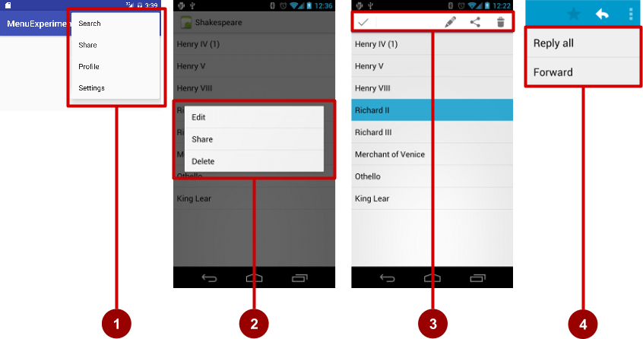
Types of Menus
App bar with options menu
Context menu
Contextual action bar
Popup menu

Slide 6
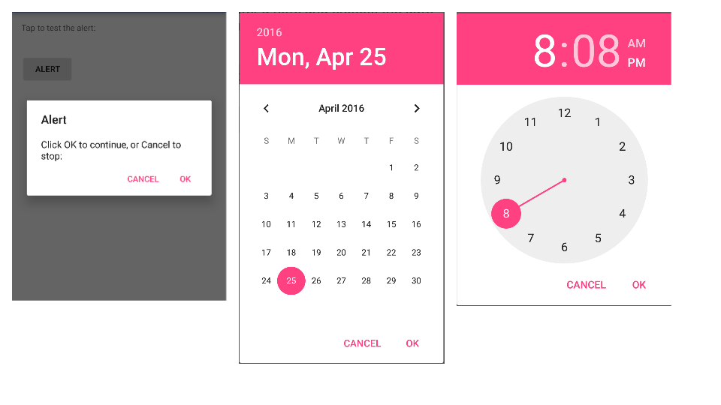
Dialogs and pickers
Alert dialog
Date picker
Time picker
1
2
3

Slide 7
App Bar with Options Menu

Slide 8
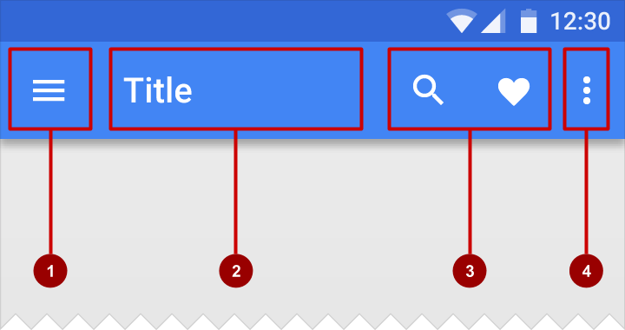
What is the App Bar?
Bar at top of each screen—same for all devices (usually)
Nav icon to open navigation drawer
Title of current Activity
Icons for options menu items
Action overflow button for the rest of the options menu

Slide 9
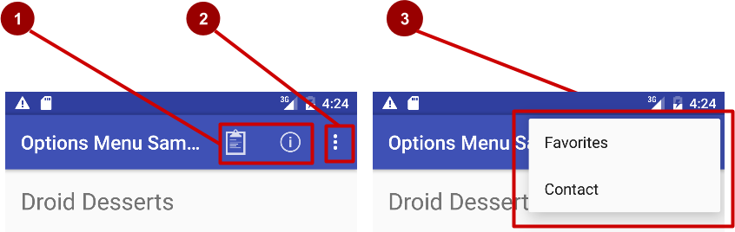

What is the options menu?
Action icons in the app bar for important items (1)
Tap the three dots, the "action overflow button" to see the options menu (2)
Appears in the right corner of the app bar (3)
For navigating to other activities and editing app settings

Slide 10
Adding Options Menu

Slide 11
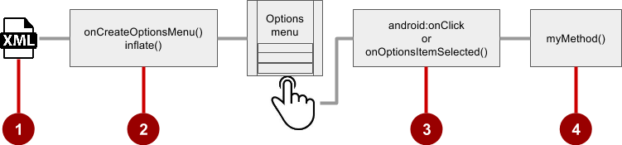

Steps to implement options menu
XML menu resource (menu_main.xml)
onCreateOptionsMenu() to inflate the menu
onClick attribute or onOptionsItemSelected()
Method to handle item click

Slide 12
Create menu resource
Create menu resource directory
Create XML menu resource (menu_main.xml)
Add entry for each menu item (Settings and Favorites):
<item android:id="@+id/option_settings"
android:title="Settings" />
<item android:id="@+id/option_favorites"
android:title="Favorites" />

Slide 13
Inflate options menu
Override onCreateOptionsMenu() in Activity
@Override
public boolean onCreateOptionsMenu(Menu menu) {
getMenuInflater().inflate(R.menu.menu_main, menu);
return true;
}

Slide 14
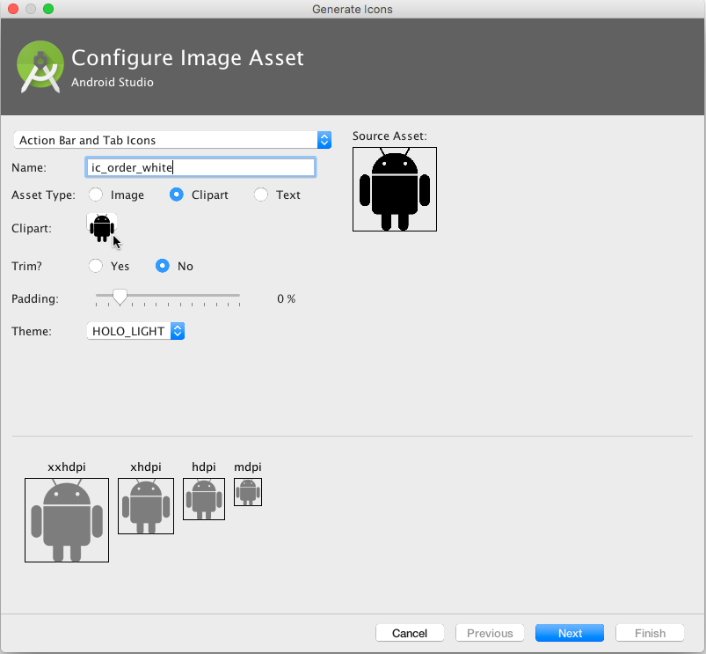
Add icons for menu items
Right-click drawable
Choose New > Image Asset
Choose Action Bar and Tab Items
Edit the icon name
Click clipart image, and click icon
Click Next, then Finish

Slide 15
Add menu item attributes
<item
android:id="@+id/action_favorites"
android:icon="@drawable/ic_favorite"
android:orderInCategory="30"
android:title="@string/action_favorites"
app:showAsAction="ifRoom" />

Slide 16
Override onOptionsItemSelected()
@Override
public boolean onOptionsItemSelected(MenuItem item) {
switch (item.getItemId()) {
case R.id.action_settings:
showSettings();
return true;
case R.id.action_favorites:
showFavorites();
return true;
default:
return super.onOptionsItemSelected(item);
}
}

Slide 17
Contextual Menus

Slide 18
What are contextual menus?
Allows users to perform action on selected View
Can be deployed on any View
Most often used for items in RecyclerView, GridView, or other View collection

Slide 19
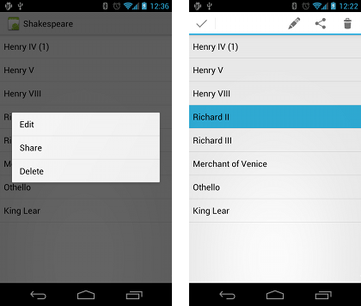
Types of contextual menus
Floating context menu—long-press on a View
User can modify View or use it in some fashion
User performs action on one View at a time
Contextual action mode—temporary action bar in place of or underneath app bar
Action items affect the selected View element(s)
User can perform action on multiple View elements at once

Slide 20
Floating Context Menu

Slide 21
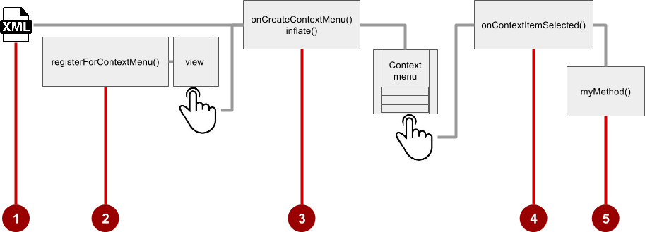
Steps
Create XML menu resource file and assign appearance and position attributes
Register View using registerForContextMenu()
Implement onCreateContextMenu() in Activity to inflate menu
Implement onContextItemSelected() to handle menu item clicks
Create method to perform action for each context menu item

Slide 22
Create menu resource
Create XML menu resource (menu_context.xml)
<item
android:id="@+id/context_edit"
android:title="Edit"
android:orderInCategory="10"/>
<item
android:id="@+id/context_share"
android:title="Share"
android:orderInCategory="20"/>

Slide 23
Register a view to a context menu
In onCreate() of the Activity:
Register View.OnCreateContextMenuListener to View:
TextView article_text = findViewById(R.id.article);
registerForContextMenu(article_text);

Slide 24
Implement onCreateContextMenu() onCreateContextMenu() method
Specify which context menu
@Override
public void onCreateContextMenu(ContextMenu menu, View v,
ContextMenu.ContextMenuInfo menuInfo) {
super.onCreateContextMenu(menu, v, menuInfo);
MenuInflater inflater = getMenuInflater();
inflater.inflate(R.menu.menu_context, menu);
}

Slide 25
Implement onContextItemSelected() onCreateContextMenu() method
@Override
public boolean onContextItemSelected(MenuItem item) {
switch (item.getItemId()) {
case R.id.context_edit:
editNote();
return true;
case R.id.context_share:
shareNote();
return true;
default:
return super.onContextItemSelected(item);
}
}
The view

Slide 26
Contextual Action Bar

Slide 27
What is Action Mode?
UI mode that lets you replace parts of normal UI interactions temporarily
For example: Selecting a section of text or long-pressing an item could trigger action mode

Slide 28
Action mode has a lifecycle
Start it with startActionMode(), for example, in the listener
ActionMode.Callback interface provides lifecycle methods you override:
onCreateActionMode(ActionMode, Menu) once on initial creation
onPrepareActionMode(ActionMode, Menu) after creation and any time ActionMode is invalidated
onActionItemClicked(ActionMode, MenuItem) any time contextual action button is clicked
onDestroyActionMode(ActionMode) when action mode is closed

Slide 29
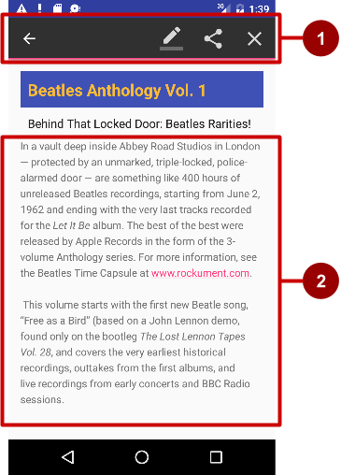
What is a contextual action bar?
Long-press on View shows contextual action bar
Contextual action bar with actions
Edit, Share, and Delete
Done (left arrow icon) on left side
Action bar is available until user taps Done
View on which long press triggers contextual action bar

Slide 30
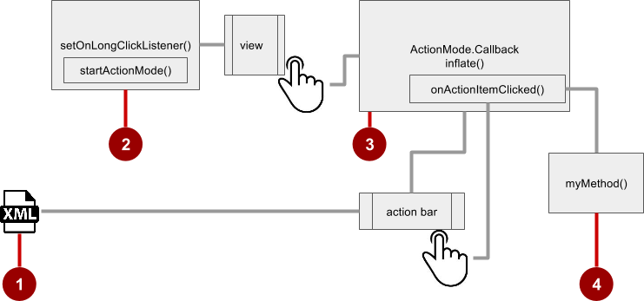
Steps for contextual action bar
Create XML menu resource file and assign icons for items
setOnLongClickListener() on View that triggers contextual action bar and call startActionMode() to handle click
Implement ActionMode.Callback interface to handle ActionMode lifecycle; include action for menu item click in onActionItemClicked() callback
Create method to perform action for each context menu item

Slide 31
Use setOnLongClickListener
private ActionMode mActionMode;
In onCreate():
View view = findViewById(article);
view.setOnLongClickListener(new View.OnLongClickListener() {
public boolean onLongClick(View view) {
if (mActionMode != null) return false;
mActionMode =
MainActivity.this.startActionMode(mActionModeCallback);
view.setSelected(true);
return true;
}
});

Slide 32
Implement mActionModeCallback
public ActionMode.Callback mActionModeCallback =
new ActionMode.Callback() {
// Implement action mode callbacks here.
};

Slide 33
Implement onCreateActionMode
@Override
public boolean onCreateActionMode(ActionMode mode, Menu menu) {
MenuInflater inflater = mode.getMenuInflater();
inflater.inflate(R.menu.menu_context, menu);
return true;
}

Slide 34
Implement onPrepareActionMode
Called each time action mode is shown
Always called after onCreateActionMode, but may be called multiple times if action mode is invalidated
@Override
public boolean onPrepareActionMode(ActionMode mode, Menu menu) {
return false; // Return false if nothing is done.
}

Slide 35
Implement onActionItemClicked
Called when users selects an action
Handle clicks in this method
@Override
public boolean onActionItemClicked(ActionMode mode, MenuItem item) {
switch (item.getItemId()) {
case R.id.action_share:
// Perform action for the Share menu item.
mode.finish(); // Action picked, so close the action bar.
return true;
default:
return false;
}
}

Slide 36
Implement onDestroyActionMode
Called when user exits the action mode
@Override
public void onDestroyActionMode(ActionMode mode) {
mActionMode = null;
}

Slide 37
Popup Menu

Slide 38
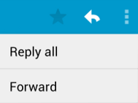
What is a popup menu?
Vertical list of items anchored to a view
Typically anchored to a visible icon
Actions should not directly affect view content
Options menu overflow icon that opens options menu
In email app, Reply All and Forward relate to email message but don’t affect or act on message

Slide 39
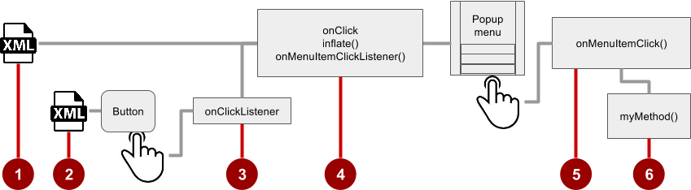






Steps
Create XML menu resource file and assign appearance and position attributes
Add ImageButton for the popup menu icon in the XML activity layout file
Assign onClickListener to ImageButton
Override onClick() to inflate the popup and register it with onMenuItemClickListener()
Implement onMenuItemClick()
Create a method to perform an action for each popup menu item

Slide 40

Add ImageButton
<ImageButton
android:layout_width="wrap_content"
android:layout_height="wrap_content"
android:id="@+id/button_popup"
android:src="@drawable/@drawable/ic_action_popup"/>

Slide 41
Assign onClickListener to button
private ImageButton mButton = (ImageButton) findViewById(R.id.button_popup);
In onCreate():
mButton.setOnClickListener(new View.OnClickListener() {
// define onClick
});

Slide 42





Implement onClick
@Override
public void onClick(View v) {
PopupMenu popup = new PopupMenu(MainActivity.this, mButton);
popup.getMenuInflater().inflate(
R.menu.menu_popup, popup.getMenu());
popup.setOnMenuItemClickListener( new PopupMenu.OnMenuItemClickListener() {
// implement click listener.
});
popup.show();
}

Slide 43
Implement onMenuItemClick
public boolean onMenuItemClick(MenuItem item) {
switch (item.getItemId()) {
case R.id.option_forward:
// Implement code for Forward button.
return true;
default:
return false;
}
}

Slide 44
Dialogs

Slide 45
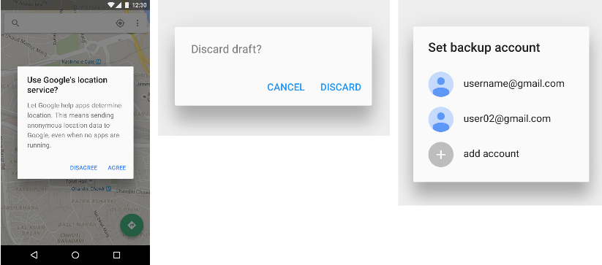
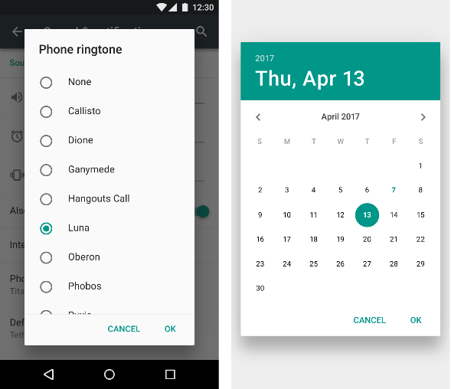
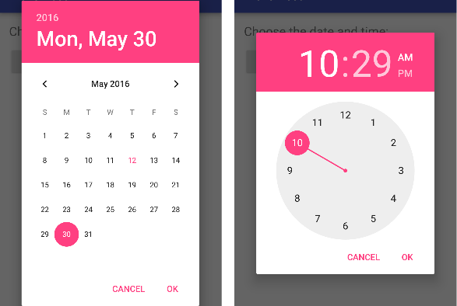
Dialogs
Dialog appears on top, interrupting flow of Activity
Requires user action to dismiss
TimePickerDialog
DatePickerDialog
AlertDialog

Slide 46
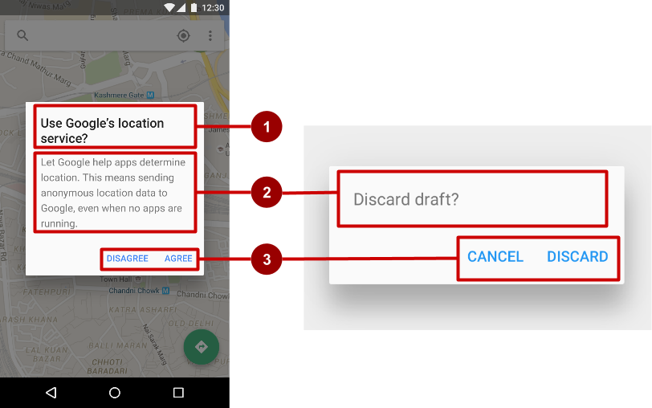
AlertDialog
AlertDialog can show:
Title (optional)
Content area
Action buttons
Notes:
Alerts are urgent interruptions, requiring acknowledgement, that inform the user about a situation as it occurs, or an action before it occurs (as in discarding a draft). You can provide buttons in an alert to make a decision. For example, an alert dialog might require the user to click Continue after reading it, or give the user a choice to agree with an action by clicking a positive button (such as OK or Accept), or to disagree by clicking a negative button (such as Cancel).
Use the AlertDialog subclass of the Dialog class to show a standard dialog for an alert. The AlertDialog class allows you to build a variety of dialog designs. An alert dialog can have the following regions (refer to the diagram below):
Title: A title is optional. Most alerts don’t need titles. If you can summarize a decision in a sentence or two by either asking a question (such as, “Discard draft?”) or making a statement related to the action buttons (such as, “Click OK to continue”), don’t bother with a title. Use a title if the situation is high-risk, such as the potential loss of connectivity, and the content area is occupied by a detailed message, a list, or custom layout.
Content area: The content area can display a message, a list, or other custom layout.
Action buttons: You should use no more than three action buttons in a dialog, and most have only two.

Slide 47
Build the AlertDialog
Use AlertDialog.Builder to build alert dialog and set attributes:
public void onClickShowAlert(View view) {
AlertDialog.Builder alertDialog = new
AlertDialog.Builder(MainActivity.this);
alertDialog.setTitle("Connect to Provider");
alertDialog.setMessage(R.string.alert_message);
// ... Code to set buttons goes here.
Notes:
The AlertDialog.Builder class provides the builder design pattern, which makes it easy to create an object from a class that has a lot of required and optional attributes and would therefore require a lot of parameters to build. Without this pattern, you would have to create constructors for combinations of required and optional attributes; with this pattern, the code is easier to read and maintain.
Use AlertDialog.Builder to build a standard alert dialog and set attributes on the dialog. Use setTitle() to set its title and setMessage() to set its message.
Note: If AlertDialog.Builder is not recognized as you enter it, you may need to add the following import statements to MainActivity.java:
import android.content.DialogInterface;
import android.app.AlertDialog;
The following creates the dialog object and sets the title (the string resource called alert_title) and message (the string resource called alert_message):
public void onClickShowAlert(View view) {
// Build the alert dialog.
AlertDialog.Builder alertDialog = new
AlertDialog.Builder(MainActivity.this);
// Set the dialog title.
alertDialog.setTitle("Connect to Provider");
// Set the dialog message.
alertDialog.setMessage(R.string.alert_message);
...

Slide 48
Set the button actions
alertDialog.setPositiveButton()
alertDialog.setNeutralButton()
alertDialog.setNegativeButton()
Notes:
Use the setPositiveButton() and setNegativeButton() methods of the AlertDialog.Builder class to set the button actions for the alert dialog. These methods require a title for the button (supplied by a string resource) and the DialogInterface.OnClickListener class that defines the action to take when the user presses the button:
You can add only one of each button type to an AlertDialog. For example, you can’t have more than one “positive” button.
You can also set a “neutral” button with setNeutralButton(). The neutral button appears between the positive and negative buttons. Use a neutral button, such as “Remind me later”, if you want the user to be able to dismiss the dialog and decide later.

Slide 49
alertDialog code example
alertDialog.setPositiveButton(
"OK", newDialogInterface.OnClickListener() {
public void onClick(DialogInterface dialog, int which) {
// User clicked OK button.
}
});
Same pattern for setNegativeButton() and setNeutralButton()

Slide 50
Pickers

Slide 51
Pickers
DatePickerDialog
TimePickerDialog

Slide 52
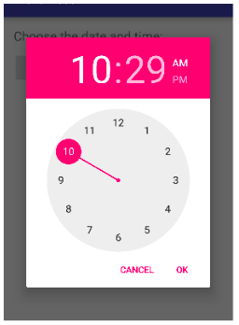
Pickers use fragments
Use DialogFragment to show a picker
DialogFragment is a window that floats on top of Activity window

Slide 53
Introduction to fragments
A Fragment is like a mini-Activity within an Activity
Manages its own own lifecycle
Receives its own input events
Can be added or removed while parent Activity is running
Multiple fragments can be combined in a single Activity
Can be reused in more than one Activity

Slide 54
Creating a date picker dialog
Add a blank Fragment that extends DialogFragment and implements DatePickerDialog.OnDateSetListener
In onCreateDialog() initialize the date and return the dialog
In onDateSet() handle the date
In Activity show the picker and add method to use date

Slide 55
Creating a time picker dialog
Add a blank Fragment that extends DialogFragment and implements TimePickerDialog.OnTimeSetListener
In onCreateDialog() initialize the time and return the dialog
In onTimeSet() handle the time
In Activity, show the picker and add method to use time

Slide 56
Learn more
Adding the App Bar
Menus
Menu Resource
Fragments
Dialogs
Pickers
Drawable Resources

Slide 57
What's Next?
Concept Chapter: 4.3 Menus and pickers
Practical: 4.3 Menus and pickers

Slide 58
END

